Slide 1
Image Inpainting using Partial Convolutions
Gaurav Kumar(23B0989)
Mrunal Vairagade(23B1031)

Slide 2
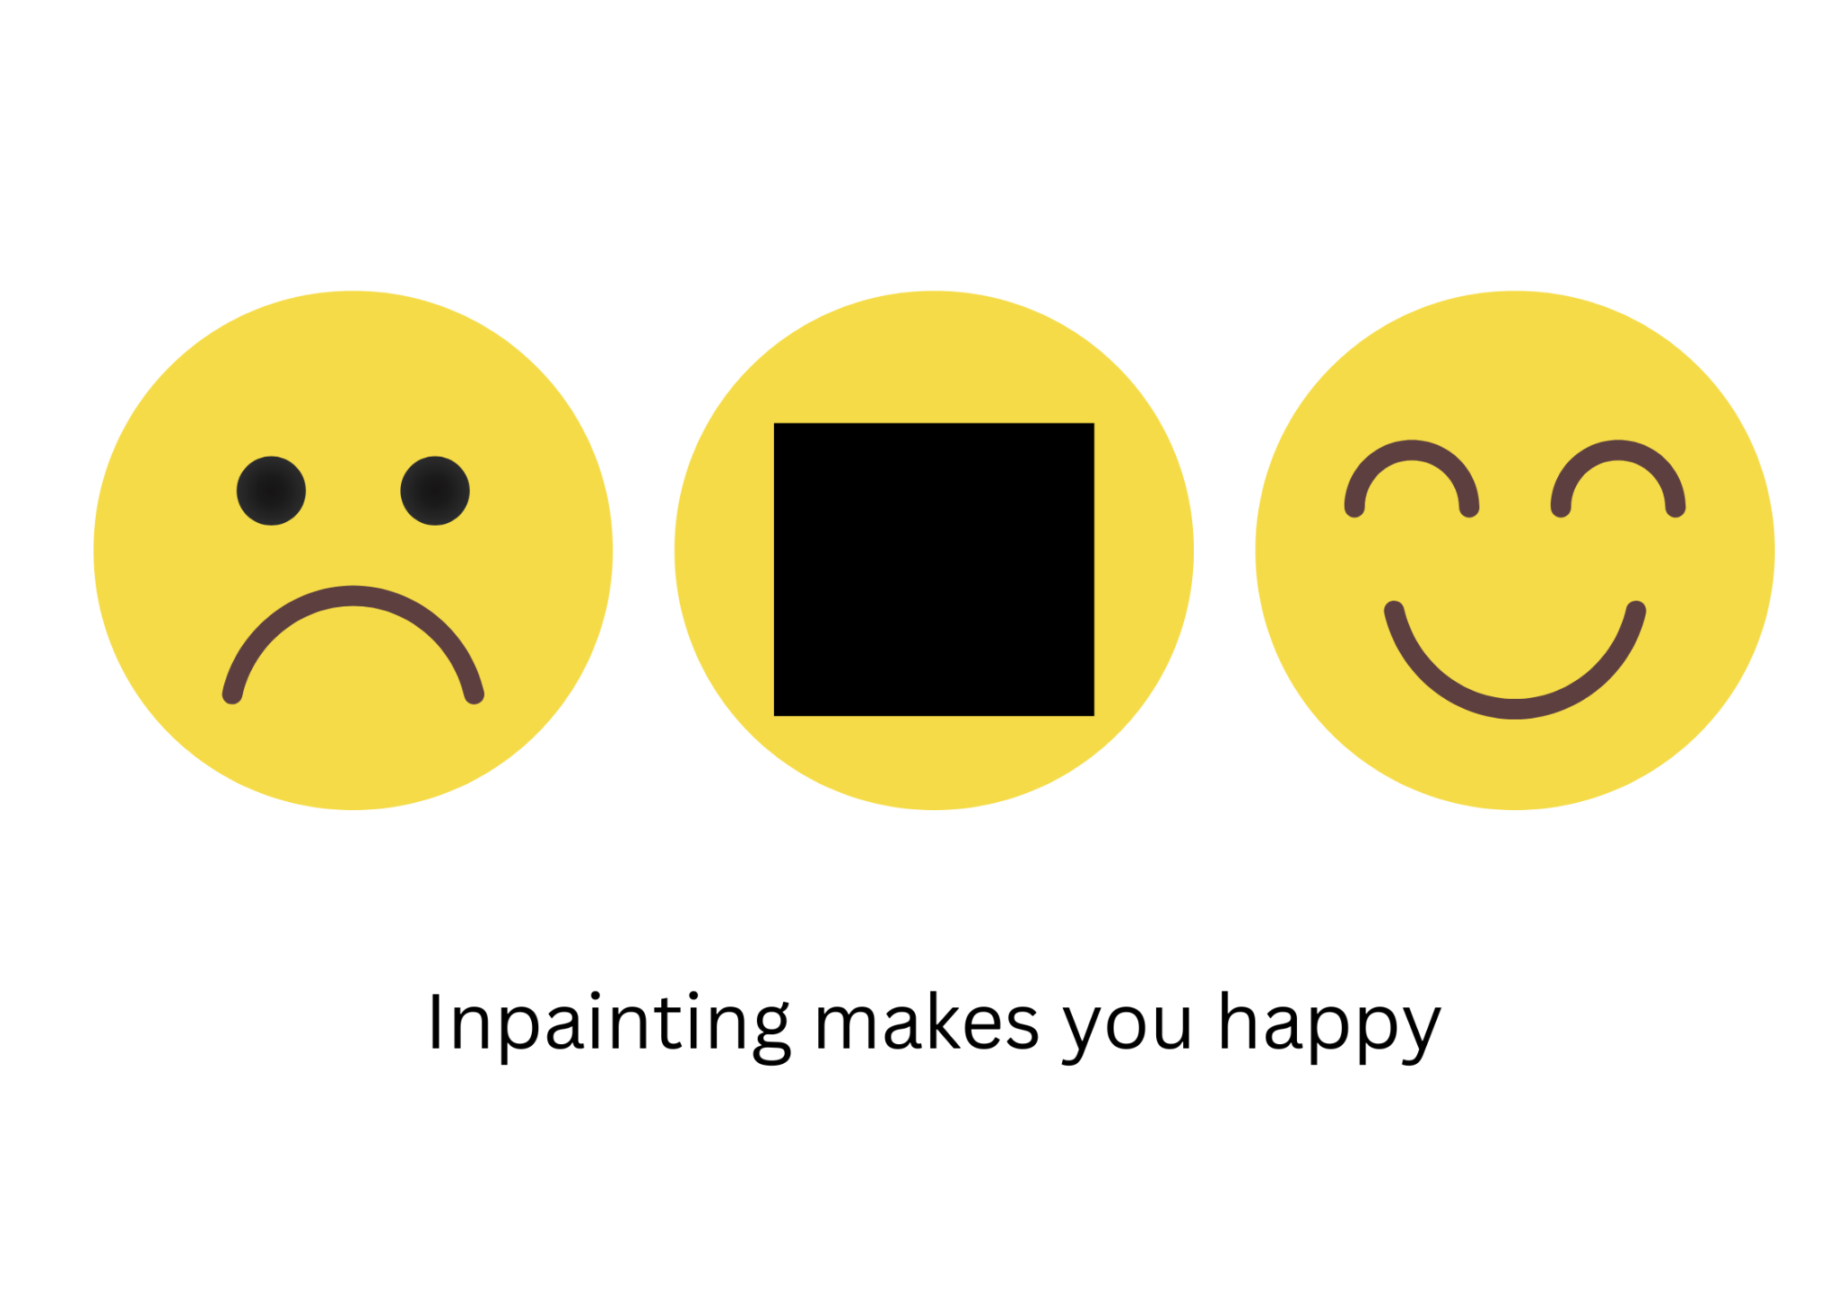

Slide 3
Overview of Method
Use partial convolution
Make a U-Net like architecture
Use L1 loss, TV loss and feature-matching loss

Slide 4
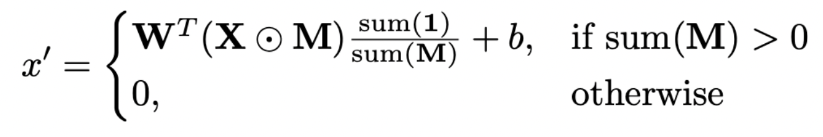
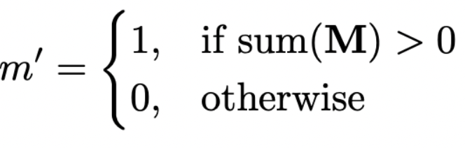
Partial Convolution Layer
Standard convolutional layers treat all pixels equally, including those inside holes (i.e., masked or missing pixels). This leads to artifacts because the network tries to learn from invalid/missing data.
So, let’s define partial convolution as
Now we define the updated binary mask as:
When we perform more and more partial convolutions, the binary mask will be eventually updated to have all ones

Slide 5
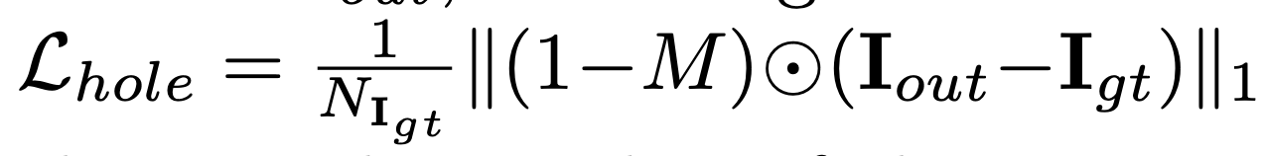
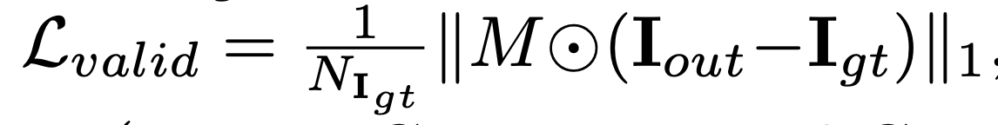
Loss Functions
L1 Loss (per-pixel loss)
M is the Mask, Igt is ground truth image and Iout is image with mask (corrupted image)
This is just L1 per pixel loss for valid and invalid pixels seperately

Slide 6
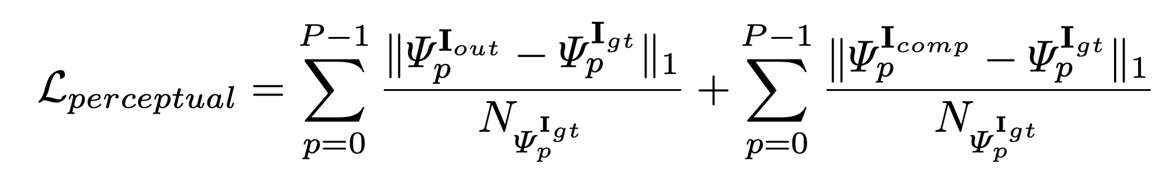
Loss Functions
Perceptual Loss
Icomp is Iout with non hole pixels directly set to ground truth pixels
This is a feature matching L1 loss between Iout and Igt and Icomp and Igt using the pretrained VGG16 feature extractor.
This is small when output is semantically close to ground truth

Slide 7
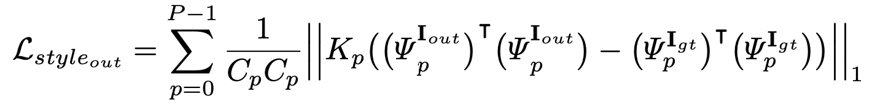
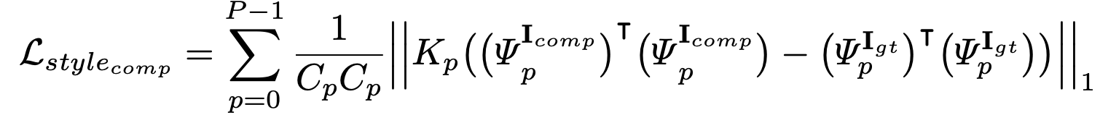
Loss Functions
Style Loss
The gram matrix (Cp) captures the correlation between feature layers. Kp is normalization factor(1/CpHpWp). Intuitively, it is there to capture style and textures in image.

Slide 8
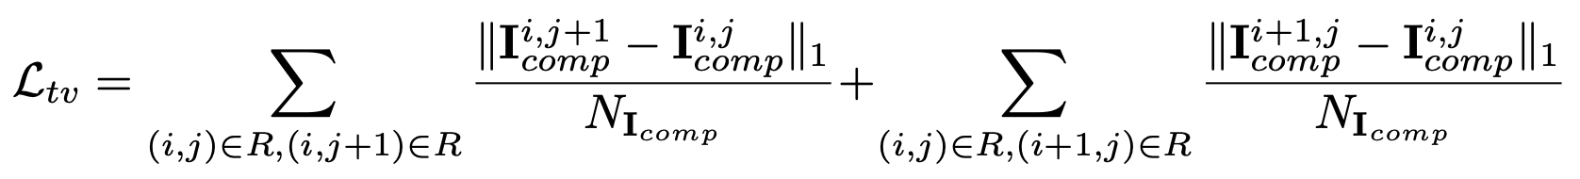
Loss Functions
Total Variation Loss (TV loss)
This is to ensure smoothness. Kind of like L1 prior.

Slide 9
Total Loss
As mentioned in the paper, the optimal combination of these losses found my hyperparameter tuning over validation set is

Slide 10
Network Architecture
We are using a U-Net like architecture consisting of encoder and decoder.
We replace all the convolution layers with the partial convolution layers as discussed before.

Slide 11
Training
We used the Adam optimizer, (which has momentum-based gradient descent) and hyperparameters as mentioned in the paper.
We trained our model CelebA dataset with 256*256 images, and masks were randomly generated. Masks were irregular shapes comprising of ellipses, lines, rectangles etc.

Slide 12
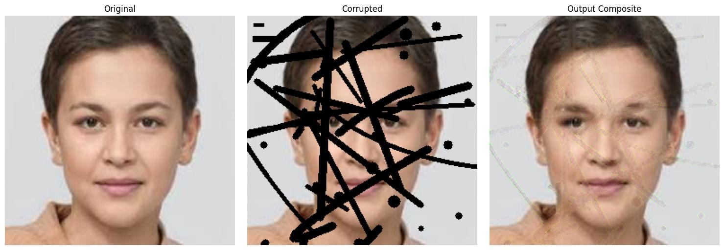
Results

Slide 13
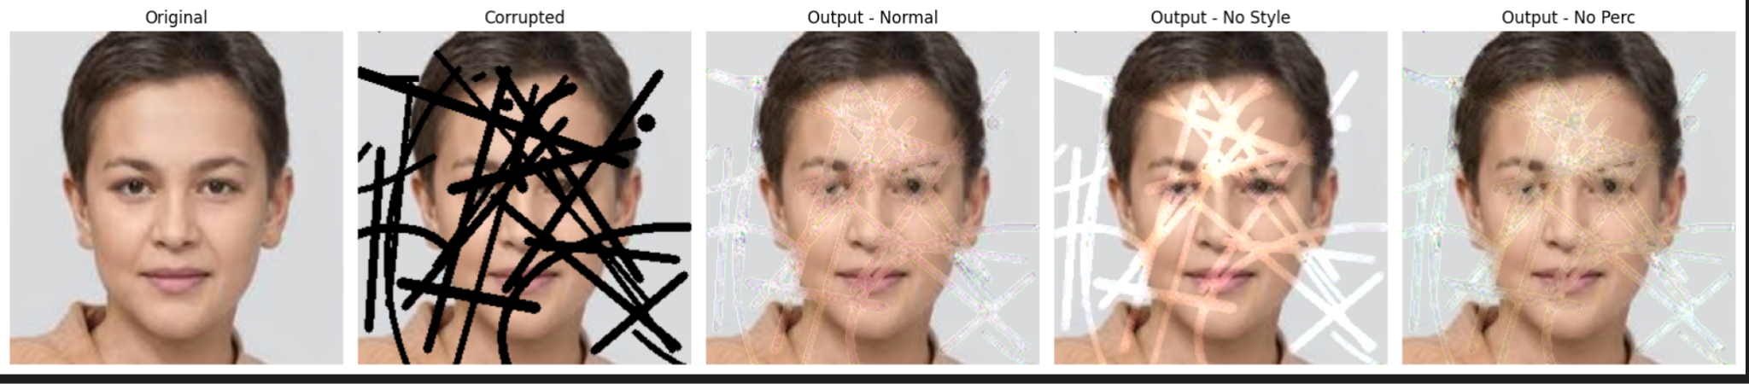
Results: with various loss experiments

Slide 14
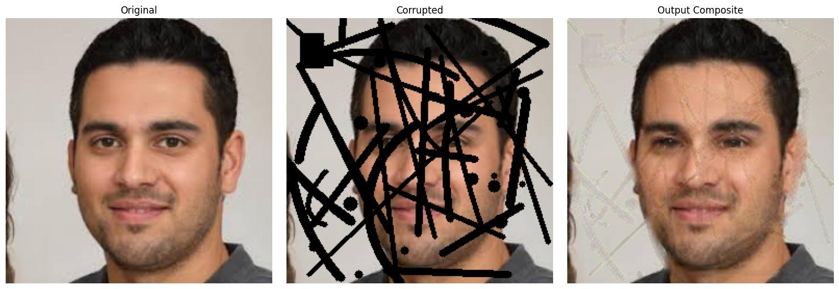
Results

Slide 15
Another application: Super Resolution
We could use image inpainting to increase image resolution. Given a 128*128 image, put a mask at alternate pixels making in 256*256, and try to inpaint these masked pixels.
We train it on 256*256 images with single mask consisting of alternate pixels.
The results are very motivating to explore inpainting as a method in super-resolution

Slide 16
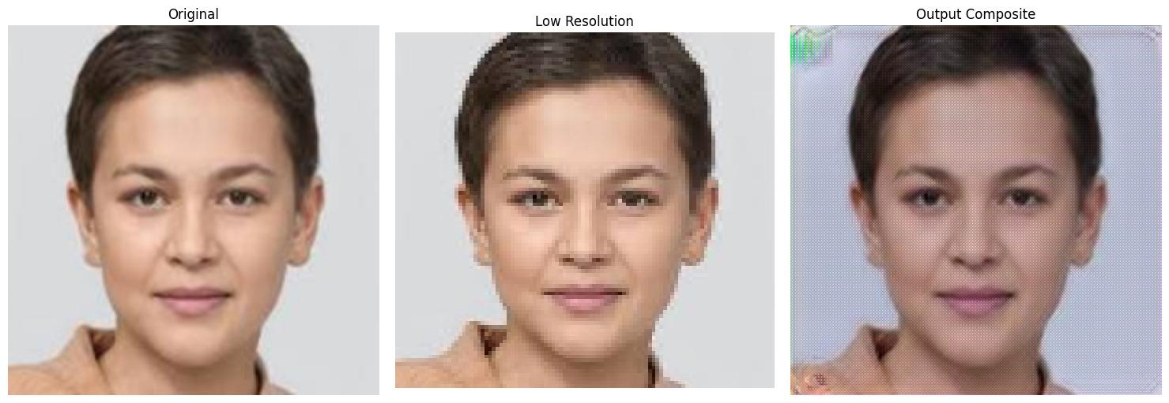
Super-resolution results

Slide 17
Applications in medical imaging
Can be used to remove artifacts from MRI and CT scans
As an image editing tool for medical practitioners

Slide 18
Link to dataset
https://www.kaggle.com/datasets/gauravkum13/celeba2
CelebA dataset modified

Slide 19
Reference
Guilin Liu, Fitsum A. Reda, Kevin J. Shih, Ting-Chun Wang, Andrew Tao, Bryan Catanzaro, Image Inpainting for Irregular Holes Using Partial Convolutions, Proceedings of the European Conference on Computer Vision (ECCV) 2018. https://arxiv.org/abs/1804.07723

